Slide 1
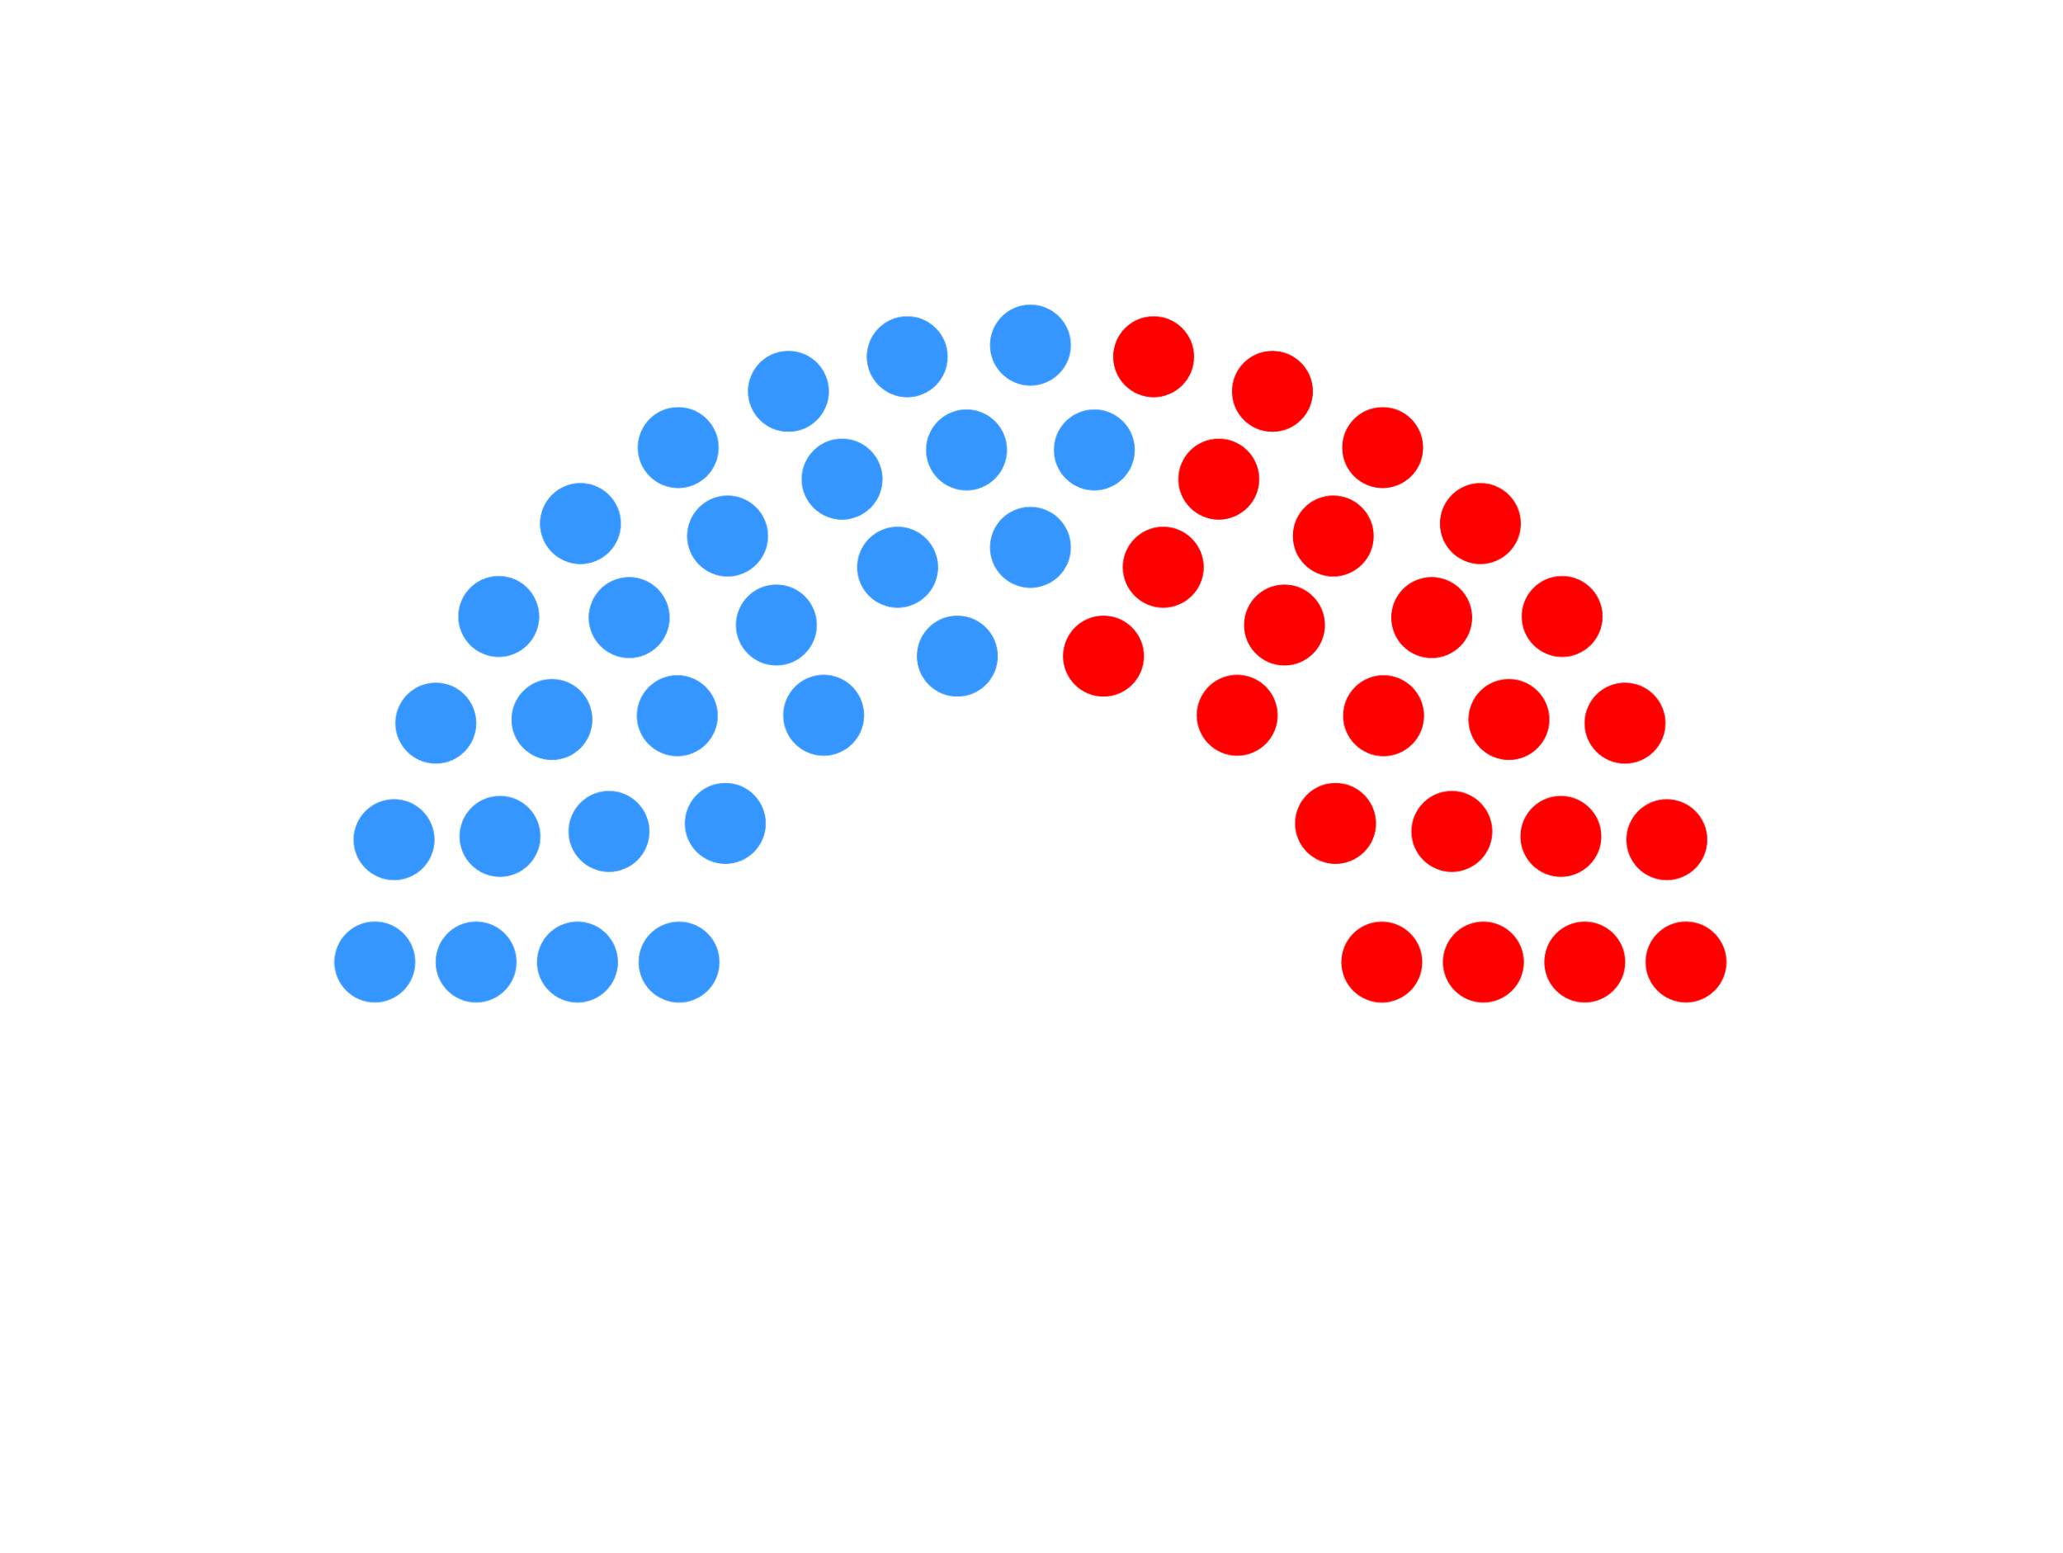
Notes:
Changed name from Quitter to Twittical

Slide 2
QUITTER/
TWITTICAL
Rishab Kanwal, Bryce Strickland, Loic Guegan, Ahmed Almutawa, Nika Shafranov

Slide 3

Mission statement: Track sentiment of tweets associated with candidates

Slide 4
Link:
http://ec2-52-38-210-101.us-west-2.compute.amazonaws.com:61621/#/homepage
A look at the varying sentiments over the past few months pertaining to presidential candidates
Notes:
This is the front end front for our sentiment analysis tools. Name off the names of the canidates and president. What we do is check the sentiment from tweets which allows us to see how people feel about current canditates . Go into trump. Talk about how Show the two different graphs then show the date range from the 15 to the 25. The sentiment Anaylsis is from 0 being totally negative to 1 being fully positive. Show the tweets down below. Talk about the date range is between the 16 and 21 for the tweets down below.

Slide 5




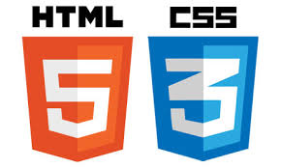

Technology Stack

Slide 6
Architectural Pattern - MVC (AngularJS)
The View is defined in HTML, while the model and controller and implemented in JavaScript
HTML templates with a ng-controller directive specifying a controller allow it to bind data from the model
Factory methods allowed for asynchronous calls to grab JSON to use for our model
Decouples view from model, controller binds to HTML

Slide 7

AngularJS Example
Binding in HTML:
<h3>Latest Tweets For {{chartTitle}}</h3>
Declaration in controller:
$scope.chartTitle = Barack Obama
Displays → Latest Tweets For Barack Obama

Slide 8

Django + Cassandra + REST API

Slide 9
Abstract Factory - Django Models
Way to encapsulate a group of individual factories with a common theme without specifying their concrete classes
A factory is the location of a concrete class in the code of a concrete class in the code at which objects are constructed

Slide 10
Abstract Factory - Django Models
class Candidate(Model):
__abstract__ = True
class Bernie(Candidate):
class Cruz(Candidate):
class Hillary(Candidate):

Slide 11
CNN Model Trainer
Employs CNN feeding LSTM into an RNN language model. Brain.
Trained on 200,000 tagged tweets. Accuracy: 84%. Humans can only agree on sentiment 80% of the time
Very modular design: High cohesion, Low coupling. Adapter design pattern
Allowed us to reuse a lot of code and identify bottlenecks quickly
Created clusters of identical machines that could be threaded efficiently

Slide 12

Takeaways
Creating an object oriented
REST API for our project
worked well due to our roles
querying database and
formatting JSON data
developing front end
Modular design allowed for seamless integration with no overlap

